Slide 1
Agile Metrics

Slide 2

Agenda
Story Points
Calculating Velocity
Tracking Sprint/Iteration Burn Down
Tracking Project Burn Up
Other Sprint/Iteration Performance KPIs

Slide 3
Story Points
What is a story point?
A story point is a relative unit of work. It is not an exact measurement of time, money or resources, rather a group consensus on the relative scale and complexity of satisfying a given requirement.
How do I determine how “much” a story point is?
It is recommended that a newly formed Scrum team go through an exercise to align on their story point scale.
Start by identifying a simple, common, and well understood generic activity that everyone in the team is familiar with.
Discuss it’s size in terms of small, medium, large. Given that it is a “simple” activity, it should feel “small” to the group. If not, identify a different activity until there is consensus on what “small” represents.
From there, branch out into easier and more complex examples until there is consensus on what extra small, large, and extra large feel like.
Assign a point scale to each size as suggested in the next slide

Slide 4
Suggested Story Point Scale
Extra Small = 1 Point
Small = 2 Points
Medium = 3 Points
Large = 5 Points
Extra Large = 8 Points
Fibonnaci Sequence
It is a common pitfall for agile teams or organizations trying to measure Scrum team efficiency, to try to equate points to hours. Story point estimations are NOT units of time, nor should they be considered as such.
As a Scrum team normalizes, velocity measurements will calculate the number of story points the team completes on average each iteration. A well formed team will generally output a similar number of points each sprint, assuming the structure and team membership remains constant.

Slide 5
Suggested Story Point Scale
What not to do – Yet, helps teams new to Agile
Story Points | Tshirt | Description | Days | Hours | Hours/SP
0.5 | XS | 1/2 day or less |  | 2 | 4
1 | S | 1 day = 8 hours | 1 | 8 | 8
2 | M | 2 days = 16 hours | 2 | 16 | 8
3 | L | 4 days = 32 hours | 4 | 32 | 10.66667
5 | XL | 7 days = 56 Hours | 7 | 56 | 11.2
8 | XXL | 2 weeks | 10 | 80 | 10
13 | XXXL | More than 2 weeks | 20 | 160 | 12.30769

Slide 6
Velocity
How much “work” (story points) gets done in a unit of time (sprint/iteration)
Total story points completed / 1 (current sprint) = Velocity of Current Sprint
Total story points completed / # of sprints (last x number of completed sprints) = Average Velocity
Why does it matter?
Average Velocity tells an Iteration Manager or Scrum Master how much output he/she can expect from the development team per iteration.
Is used in Sprint Planning sessions to scope out the planned output of a forthcoming sprint. See example 1.
Is also used to determine the overall scope of a project. See example 2.

Slide 7
Velocity Examples
Example 1
A team of 5 developers has completed 6, 10, and 8 story points in the last three consecutive sprints. Their average velocity is 8 story points. Therefore, when planning the next iteration, 8 story points should be the team’s benchmark capacity.
Example 2
A new project is starting and based on initial high level (tee shirt) estimates, is expected to cost 100 story points to complete.
Using the team from example 1 at an average of 8 story points per sprint, it will require 12.5 or 13 sprints to complete this project.
Assuming a sprint duration of 3 weeks, this project will require 273 days or 39 weeks to complete.
This information is used to develop release plans and to manage demand for agile teams.

Slide 8
“Guess-timating” Tips
Numbers are for Facts, Ranges are for Estimates
Make and document assumptions
If they don’t hold true – neither does the estimate
The less information there is the larger the estimate
When in doubt – go up
Estimation != Commitment
Being wrong is not bad – learn from it
Have you ever done this before?

Slide 9
What level is right?
Epics – Level of Effort
# Sprints, # Months
Stories – Story Points
Fibonacci Sequence, T-Shirt Sizing
Tasks - Hours

Slide 10
Guess-timating techniques
Planning Poker
Bop-it
Rapid Release
Aggregate estimates
Calibrate with real team Velocity

Slide 11
Estimating Pitfalls
Forgetting about all the “other stuff” – Definition of Done
Documentation
Meetings to discuss
Research
Testing
Wanting to please – will only fail
Never negotiate estimates – especially if you are doing the work
Not knowing what is most important to your stakeholder –
The iron triangle – Time, $, Scope
Not having enough time and a safe place for team to estimate their work
Not adjusting for how well we estimated before

Slide 12
Tracking Sprint/Iteration Burn Down
Burn Down tracks the amount of work completed over time within a sprint.
It is used to help a Scrum Master determine whether the team will meet their commitments by the end of the iteration. It can be also be used to:
Track amount of outstanding development work vs. number of days remaining
Track amount of outstanding testing work vs. number of days remaining
Project number of remaining development days based on incomplete work and development team velocity
Project number of remaining testing days based on incomplete work and QA team velocity
Burn Down provides signals to the Scrum Master of how the Sprint is faring and whether escalations to project/program stakeholders are required.

Slide 13
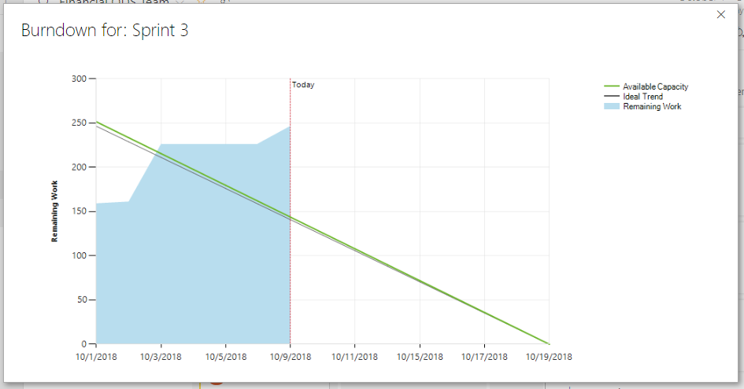
DevOps Burn Down Chart

Slide 14
Burn Down Chart Definitions
Ideal Burn Down: This line provides a benchmark for how much work on average must be completed per day in order to complete all work by the end of the iteration. This is not achievable, only a tool for comparison against the team’s actual pace.
Actual Burn Down: This is an accrual measure of work completed over the days passed in the iteration.
Burn Rate Variance: This metric accrues the difference between the Actual Burn Down and the Ideal Burn Down over the days passed in the iteration. This tells the Scrum Master whether the team is trending closer to or further away from the ideal Burn Down.
DEV Days Remaining: Defined as remaining Development Story Points / Average daily Velocity of the Developers. This answers the question “Assuming the developers work at their normal pace, how many days will they need to finish the outstanding work?”.
QA Days Remaining: Same as DEV Days Remaining just oriented towards the outstanding testing work and the testers who will do that work.

Slide 15
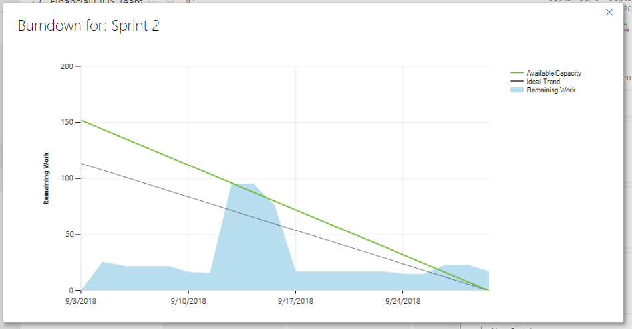
DevOps Burn Down Chart
What happened?

Slide 16
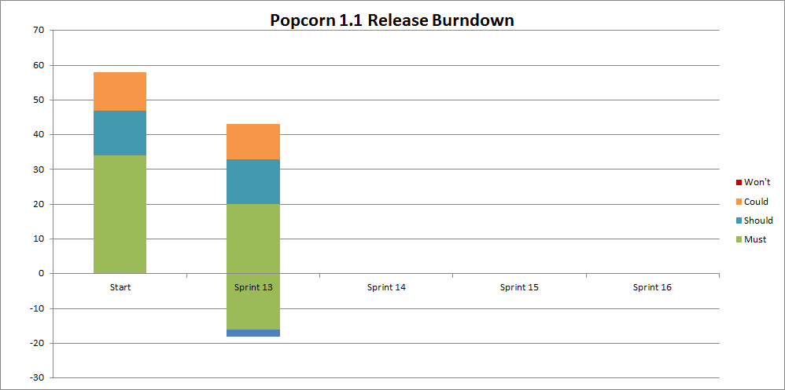
Release Burn Down Chart

Slide 17
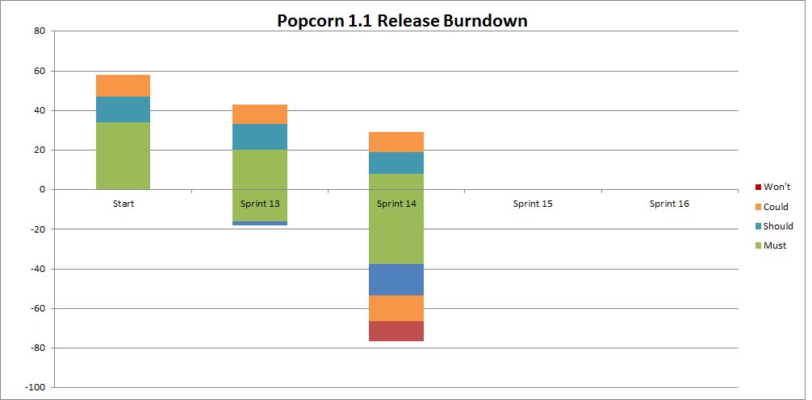
Release Burn Down Chart

Slide 18
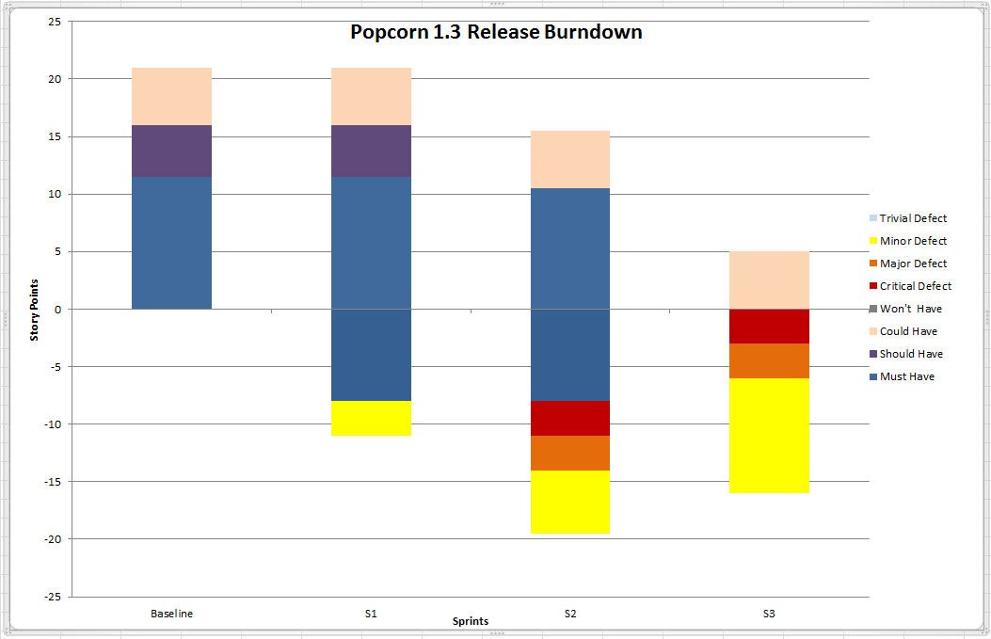
Release Burn Down Chart

Slide 19
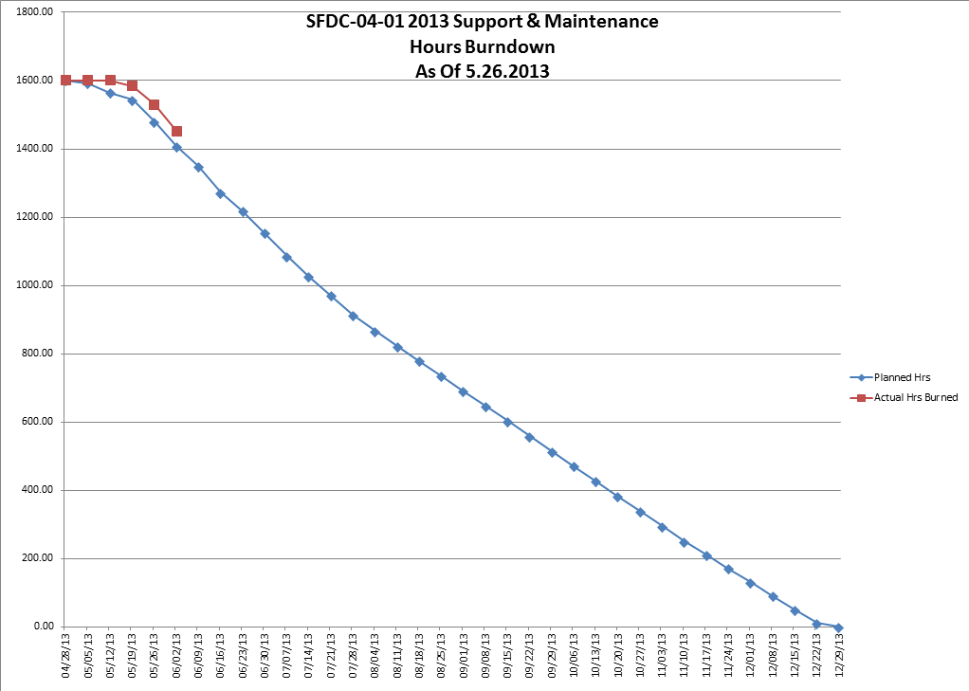
Hours Burn Down Chart

Slide 20
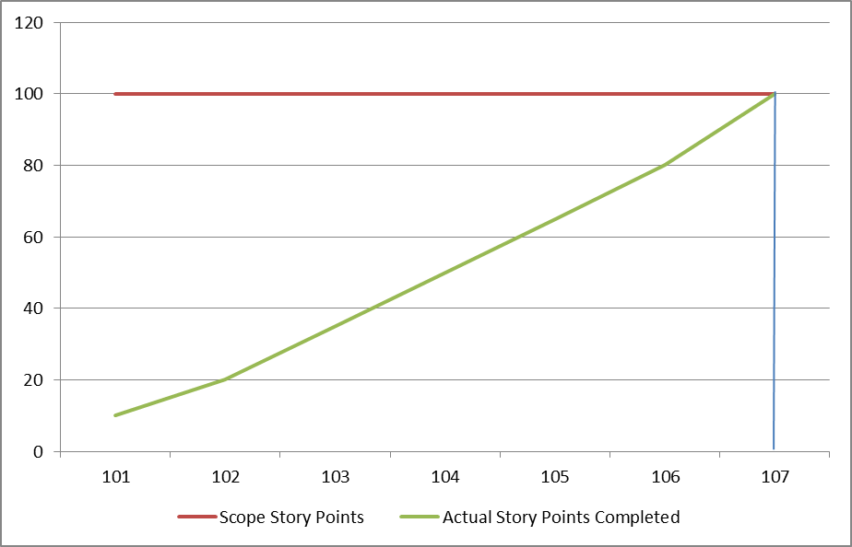
Tracking Project Burn Up
Given a fixed scope and a team’s average velocity, we can predict the number of iterations required to complete a project. But as we know, scope rarely remains constant. So how do we articulate the impact of scope change on project timelines?
Expected complete here
Consider a project with 100 points of scope, we can plot the expected completion date based on the team’s average or actual velocity.
That’s nice but what happens if scope increases?

Slide 21
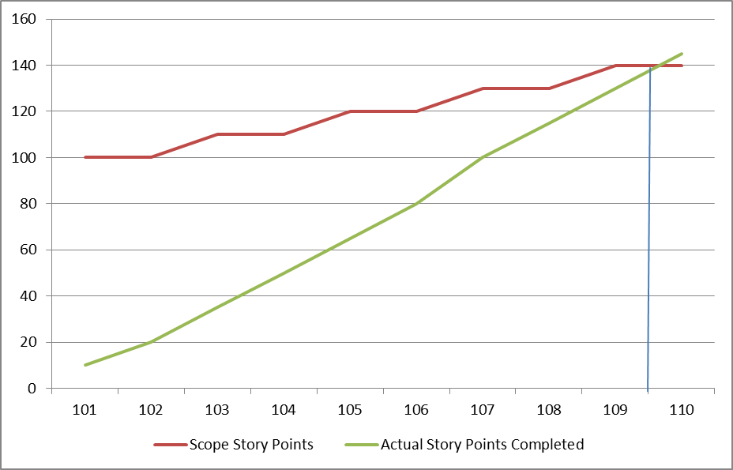
Tracking Project Burn Up
Let’s assume that this project suffers from gradual scope creep over time. Without somehow changing the team’s velocity (Not easy to do on demand), there is no way to maintain original timelines.
New expected complete here
In this case, the project will now finish three iterations later which translates to additional cost.
This emphasizes the importance of documenting scope changes in story cards along with point estimates for each. Now it’s a business decision of whether to spend the extra time/money up front instead of an “oops” after the fact.

Slide 22
Other Sprint/Iteration Performance KPIs
% Stories Completed
# of Stories completed / # Stories committed in sprint planning
This tells an organization how much of their pre-sprint commitments are being met by the end of the sprint, in terms of whole story cards.
% Story Points
# of Stories points completed / # Stories points committed in sprint planning
Accounts for partially completed stories whereas % Stories Completed does not
Hangover
# of committed Stories not completed in prescribed iteration/sprint
Provides a gauge for the degree of leftover work that will displace the output of the next sprint.

Slide 23
Sources
Agile KPIs
http://www.slideshare.net/mgaewsj/agile-kpis-5853270
http://www.certschool.com/blog/agile-burn-up-chart/

